Slide 1
IEEE BOMBAY SECTION

Slide 2
History
In 1976, the Bombay Section was formed with a Territory of Maharashtra, Goa, Gujarat (which later separated to form a Section itself on 15th August 1990), Madhya Pradesh (now includes newly formed Chhatisgarh) and Diu & Daman UT (Except Pune Metropolitan City which is separate Section from 26th June 2010) , closely followed by Banglore & Delhi.

Slide 3
Chapters
AP/ED Chapters
Communication Society Chapter
Computer Society Chapter
Instrumentation and Measurement Society Chapter
Microwave Theory and Techniques Society (MTT-S) Chapter
Power Engineering/Industry Application Society Joint Chapter
“Life Member (LM) Chapter of Bombay Section”
Microwave Theory and Techniques Society (MTT-S) Chapter
Power Engineering/Industry Applications Society Joint Chapter

Slide 4
Chapters
Signal Processing Society (SMCS) Chapter
Technical Management Council Chapter
LM Affinity Group
GOLD Affinity Group
WIE Affinity Group

Slide 5
Executive Committee 2014

Slide 6
Executive Committee 2014n

Slide 7
MP Sub-Section
The MP Subsection was formed in the year 2001 under the able guidance of the Dr. Mrs. S. Kher of Indore. Currently, being Chaired by Dr. DK Mishra.

Slide 8
IEEE BOMBAY SECTION-2013/14

Slide 9
Conferences
Renewable Energy and Energy Efficiency – May 2013 Paving the Path to Profitability
Industry Outreach Program – Aug 2013
Internal Security - Oct 2013 Technologies to Pre-empt and Protect
R10 South Asia Conference Leadership Program - Dec 2013
INDICON 2013 – Dec 2013 [with large Exhibition (Industry / Academia participation)]

Slide 10
Section Highlights
New Regional Committee Formation
Nagpur
Gwalior
Chhattisgarh
New Bombay Section Website
New Bombay Section Logo
Senior Member Drive - increase of 50%
Institution of Section Awards

Slide 11
Industry Association Partnerships/Collaboration
Indo German Chamber of Commerce (IGCC)
Bombay Chamber of Commerce & Industry (BCCI)
Project Management Institute (PMI)

Slide 12
Student Activities-Highlights
First Student National Conference
(K Shankar Student National Conference)
Formation of Bombay Section Student Network
Regional Branch Counselor Meets
Mumbai
Bhilai
Nagpur
20 New Bombay Section Student branches
International University Fair

Slide 13
Others
SKEP lecture series
Working models of JC Bose's original experiment and Raman Amplifier
‘SIGHT’ Chapter in IEEE Bombay Section
Formation of Microwave Theory & Techniques Society Chapter

Slide 14
Conference on Renewable Energy and Energy Efficiency
Paving the Path to Profitability

Slide 15
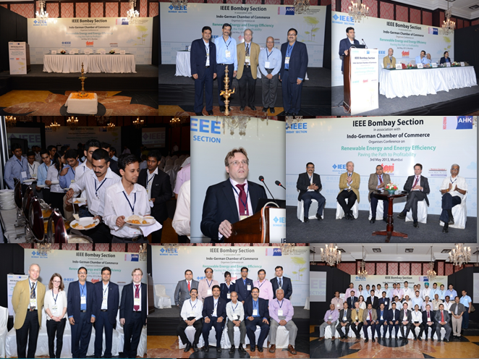

Slide 16
Industry Outreach Program

Slide 17
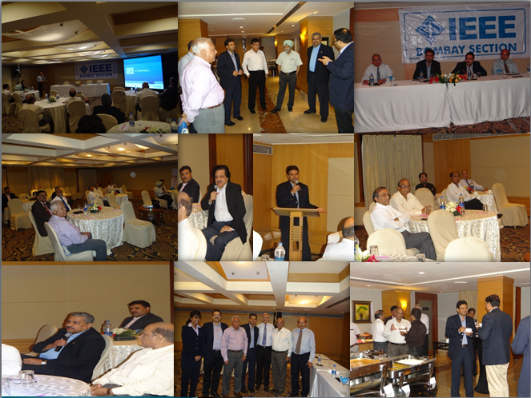

Slide 18
Conference on Internal Security:
Technologies to Pre-empt and Protect

Slide 19
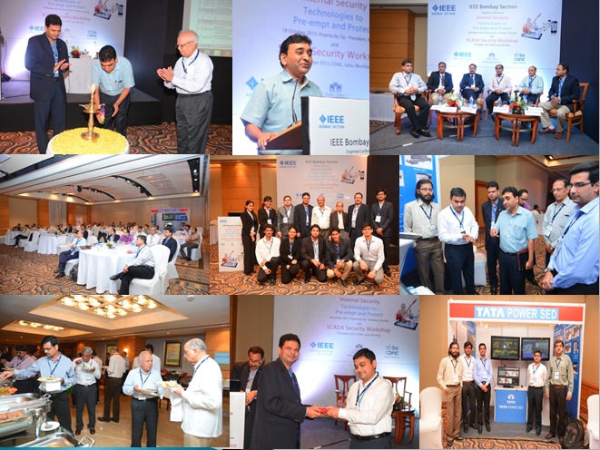

Slide 20
Formation of Regional Committees

Slide 21
Initiating Chattisgarh Regional Activities

Slide 22
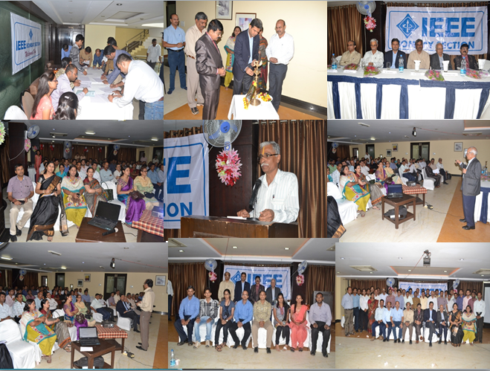

Slide 23
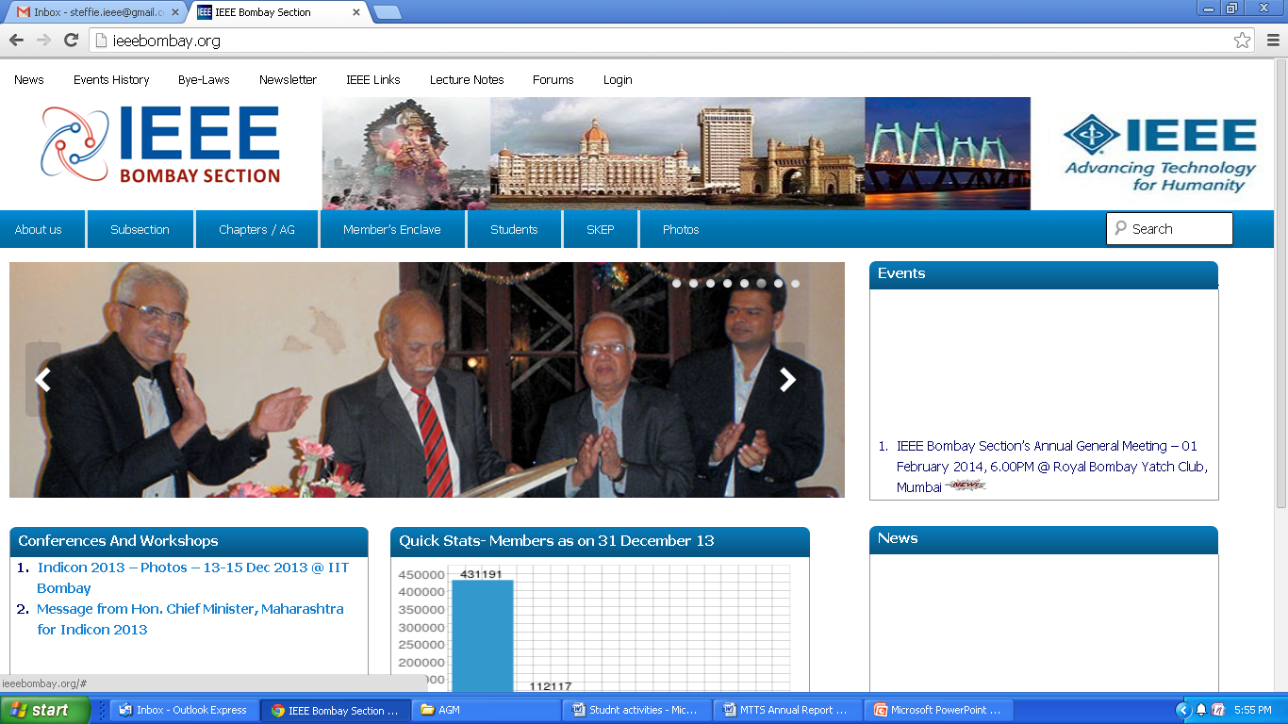
New IEEE Bombay Section Website

Slide 24
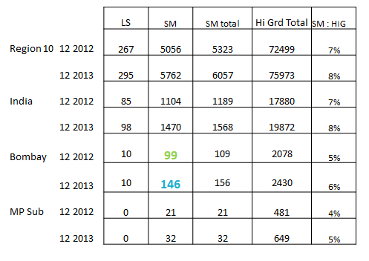
Senior Membership Drive

Slide 25
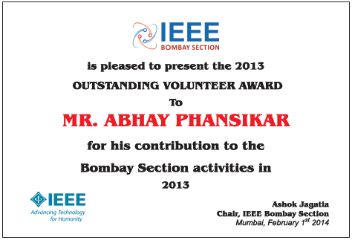
Institution of Section Awards

Slide 26
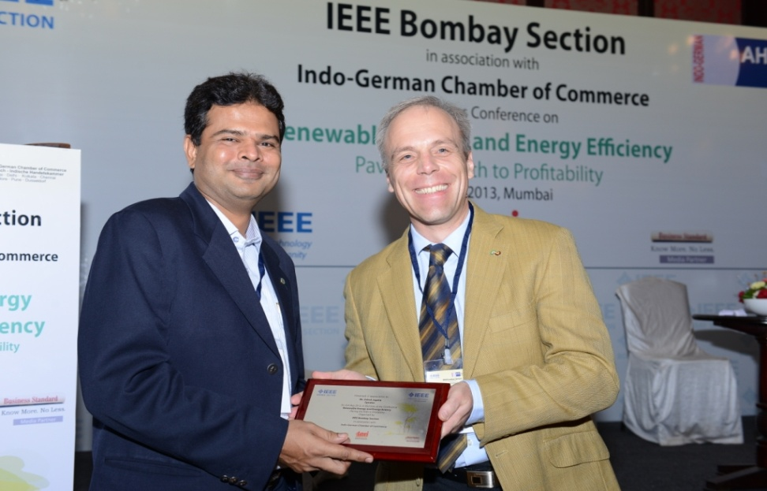
1st Time partnership with IGCC and BCCI for events

Slide 27
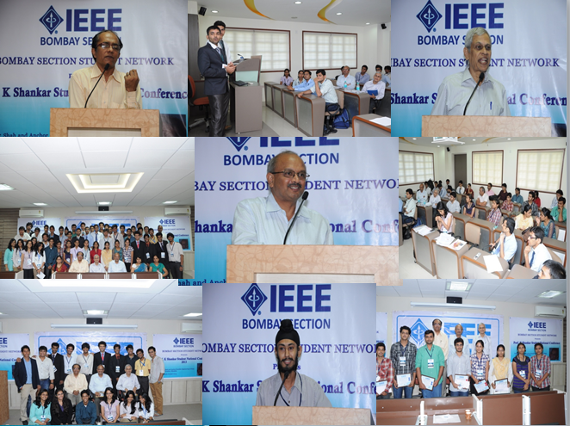
K Shankar Student National Conference

Slide 28
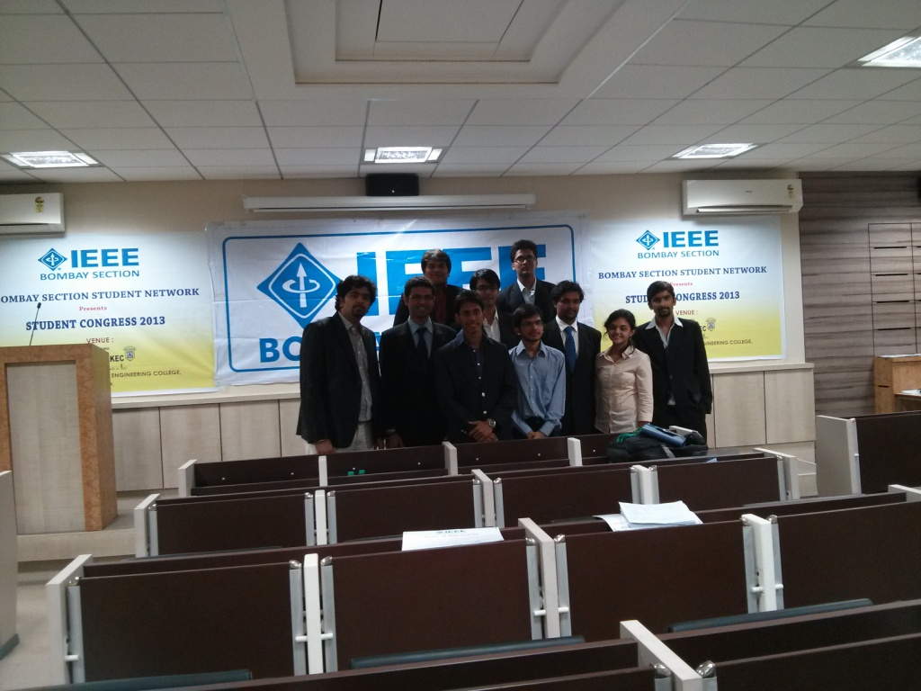
Formation of Bombay Section Student Network

Slide 29
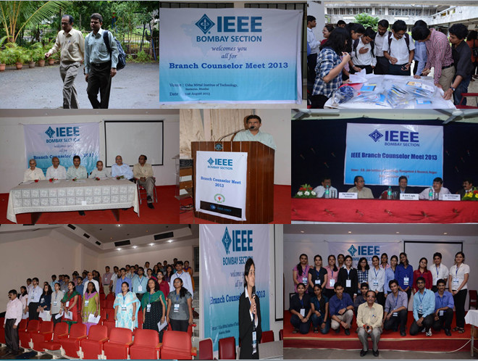
Regional Branch Counselor Meet

Slide 30
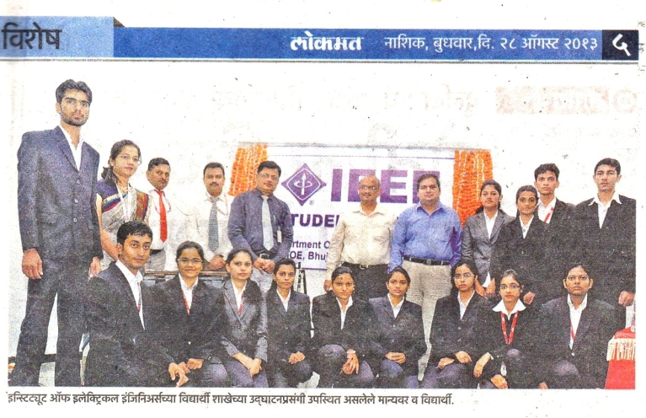
Formation of 20 New Student Branches

Slide 31
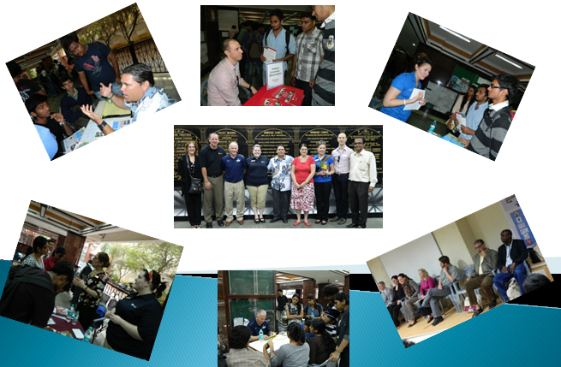
International University Fair

Slide 32
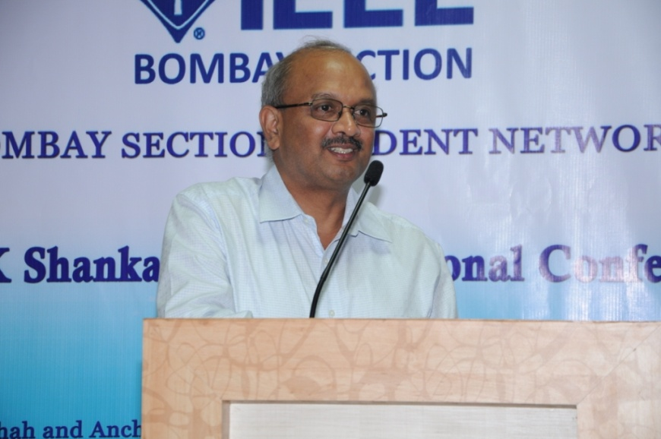
Skep Lecture Series

Slide 33
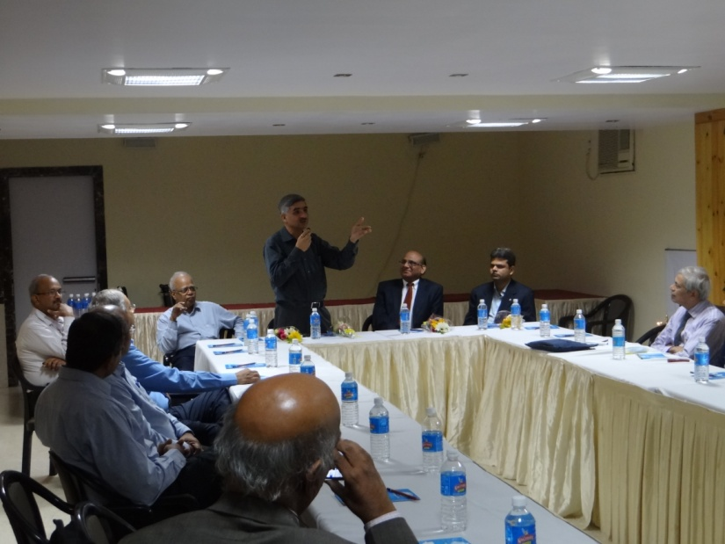
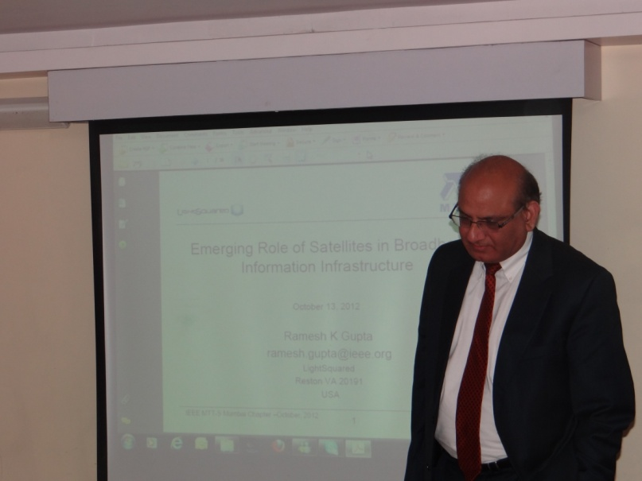
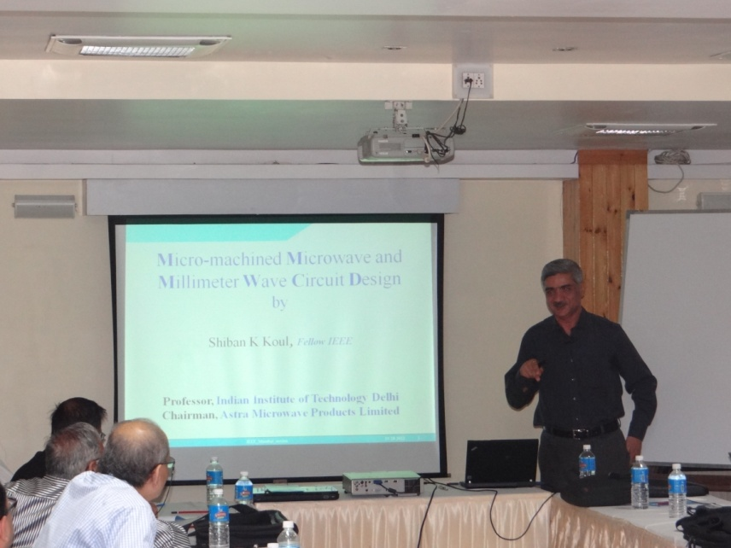
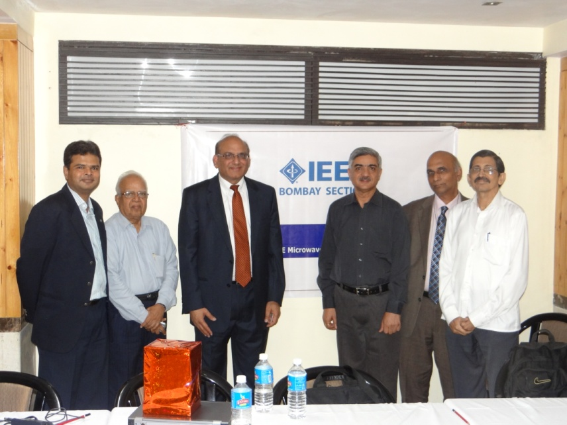
Formation of MTTS Chapter

Slide 34
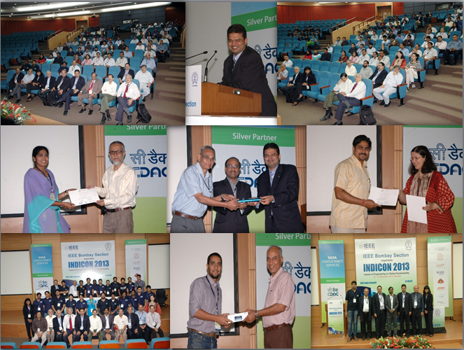
Indicon 2013

Slide 35
Thank You

