Slide 1
Big Data Security Analytics - Detection and Prevention of Criminal, Terror Acts with Real Time Analysis of Suspicious Events, Patterns and Criminal Linkages
Kamini Rupani
Vice President – Marketing

Slide 2
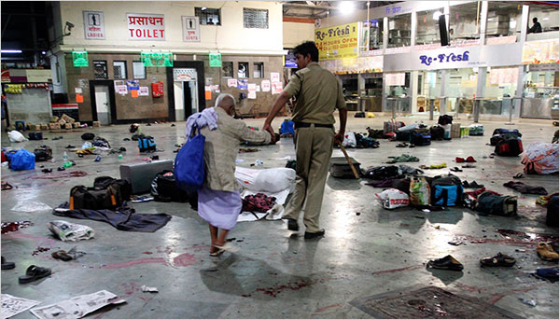
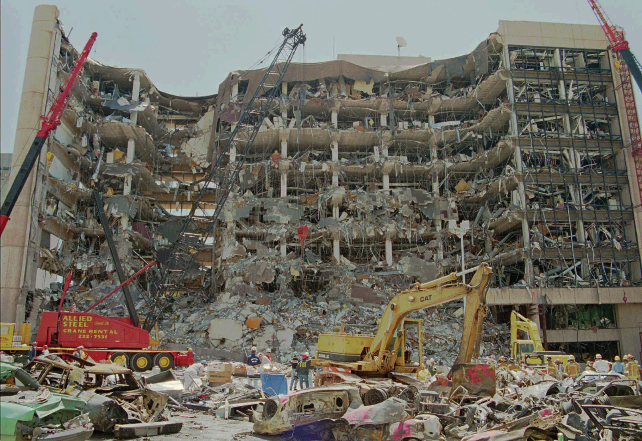
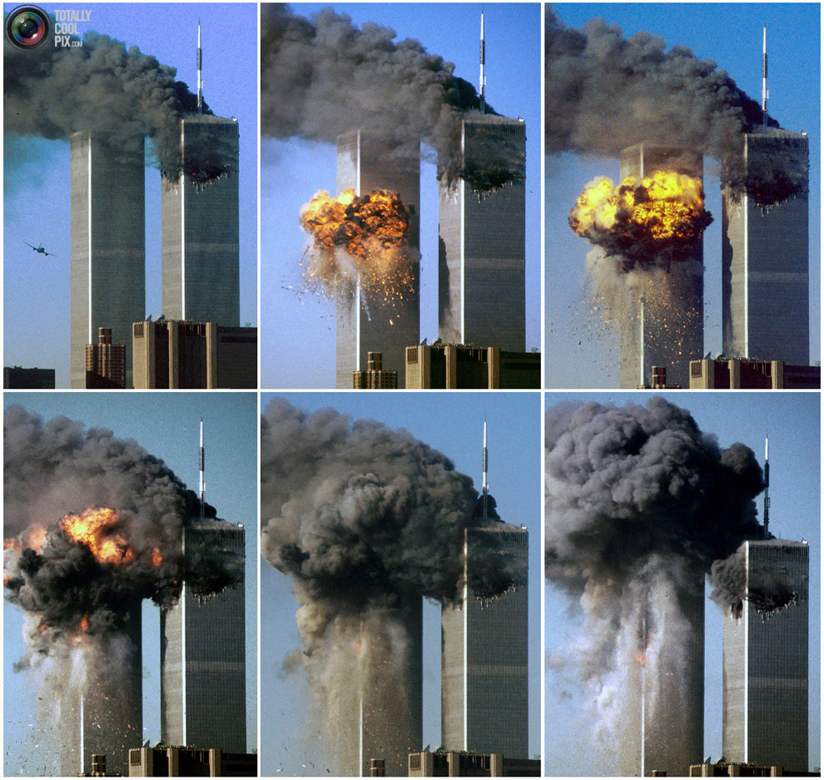
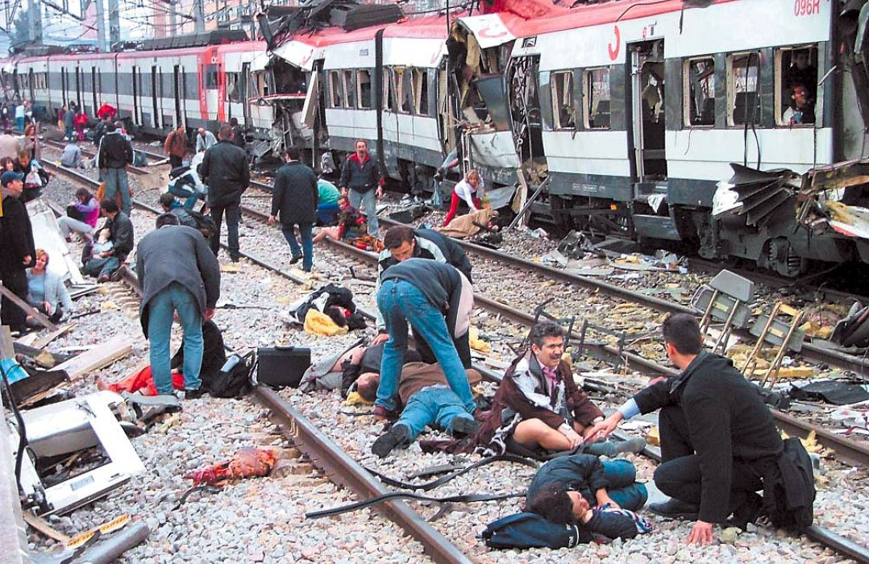
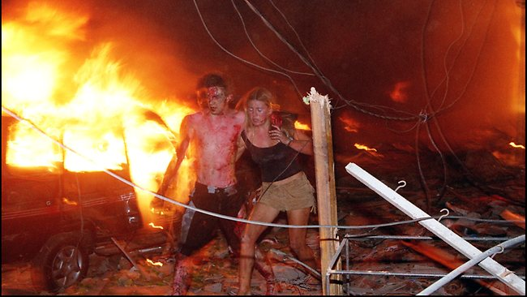
Boston Marathon Bombings 2013 Dead: 5 Injured: 280
Madrid Train Bombing 2004 Dead: 191 Injured: 2050+
Mumbai Terror Attack 2008 Dead: 173 Injured: 600+
Oklahoma 1995 Dead: 168 Injured: 680
World Trade Center 2001 Dead: 3000 Injured: 6000+
Bali Bombings 2002 Dead: 202 Injured: 209

Slide 3
Effect of Terrorism
Terrorism caused an average of 8200 fatalities per year worldwide
Terrorist incidents grew over 1000% in a span of 10 years
Retrieved from www.start.umd.edu/gtd

Slide 4
Criminals are Early Adopters
Advances in mobile technologies give terrorists a tactical advantage that could be difficult to corral, experts say. (AP Photo/Elaine Thompson)
MUMBAI, India — Terrorists … stunned authorities with their use of sophisticated weaponry & their comfort with modern technology...
EARLY ADOPTERS

Slide 5
Coordination Challenge is High
Delayed information delivery within the same organization
Non-uniform data leads to severe inefficiency in the analysis process
No connectivity among information systems and databases
Lag in procuring data causes unnecessary delay in obtaining Actionable Intelligence
Not sharing between agencies means work duplication
Crime and terrorism require sophisticated techniques

Slide 6
HOW CAN WE COMBAT TERRORISM
PREVENT THE MISHAPS
BEFORE THEY HAPPEN
PUT THE CRIMINALS BEHIND THE BARS
AND SAVE PRECIOUS LIVES
Retrieved from http://www.start.umd.edu/gtd

Slide 7
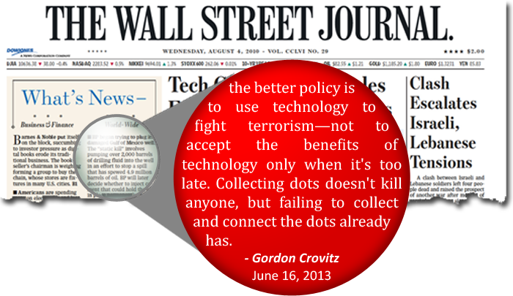
THE ANSWER IS TECHNOLOGY

Slide 8
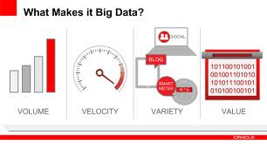
Big Data
Notes:
What is Big Data?
Volume: The amount of data. Perhaps the characteristic most associated with big data, volume refers to the mass quantities of data that organizations are trying to harness to improve decision-making across the enterprise. Data volumes continue to increase at an unprecedented rate. However, what constitutes truly “high” volume varies by industry and even geography, and is smaller than the petabytes and zetabytes often referenced. Just over half of respondents consider datasets between one terabyte and one petabyte to be big data, while another 30 percent simply didn’t know how big “big” is for their organization. Still, all can agree that whatever is considered “high volume” today will be even higher tomorrow.
Variety: Different types of data and data sources. Variety is about managing the complexity of multiple data types, including structured, semi-structured and unstructured data. Organizations need to integrate and analyze data from a complex array of both traditional and non-traditional information sources, from within and outside the enterprise. With the explosion of sensors, smart devices and social collaboration technologies, data is being generated in countless forms, including: text, web data, tweets, sensor data, audio, video, click streams, log files and more.
Velocity: Data in motion. The speed at which data is created,processed and analyzed continues to accelerate. Contributing to higher velocity is the real-time nature of data creation, as well Big data in dimensions and decision making. Velocity impacts latency – the lag time between when data is created or captured, and when it is accessible. Today, data is continually being generated at a pace Variety Data in many formsStructured, unstructured, text, multimedia.Velocity Data in motion Analysis of streaming data to enable decisions within fractions of a second Data uncertainty Managing the reliability and predictability of inherently imprecise data types as the need to incorporate streaming data into business processes

Slide 9
TYPES OF DATA
STRUCTURED
Telecom CDR
SEMI / UNSTRUCTURED
LI Intercepted content of Communication (CC) that includes
-Web Session Data
-Email Communication data
-P2P Communication Data
-Chat Contents (P2P and IRC based)
(EntityBased) Suspect/Target Data
(Location specific) Base Tower Station Data
Internet IPDR
(EntityBased) Suspect/Target IP Data
(Location specific) Subnet Data
Subscriber Detail Records (SDR)
Master refernce for Telecom Data like Numbering, BTS IDs etc
Master refernce for Internet Master Data
GeoLocation Reference Data for BTS and IPs
Passive Probed Internet Data for
-News Feeds
-Blogs
-Social Networking Sites
-General Web site data
-LEA/User specific
Investigation / intelligence Reports and Documents

Slide 10
Different Types of Data Handling
Telecom
Subscriber
Call Detail Records (Voice, SMS)
Travel
Un- Structured
Intercepted E-mail
Banking
Location Updates
Bank Records
ATM Records
Credit Card Transactions
Journey Transactions
Hotel Bookings
Intercepted Chat
Intercepted Facebook
Intercepted Twitter
IRI
GIS Data Feeds
Passport & Immigration
Department of Motor Vehicle
Income Tax
Surveillance Feeds
Notes:
Different Data Sources handling is complex but gives enhanced insights in narrowing down a Criminal’s pattern. In today’s crime Scenarios, ability to handle diverse data sources is key to drive to Actionable Intelligence. The linkages that can be formed between suspicious events with varied data sources can become key for a Law Enforcement Agent in solving a Corruption, Money Laundering, Drug Trafficking, etc. case. You can see the varied data that can be analyzed easily.

Slide 11
Why are we here?
Location
Centric
Details
UIDAI
GIS DATA
Reservation
Details
Financial
Details
What do I do with this data?
How do I make it useful for me
Can I identify suspect with this data quickly?
I have a case help me solve it with this data?
Call Records
Subscriber
Profiles
Property
Vehicle Insurance Details
Passport
Driving License
Pan Card

Slide 12
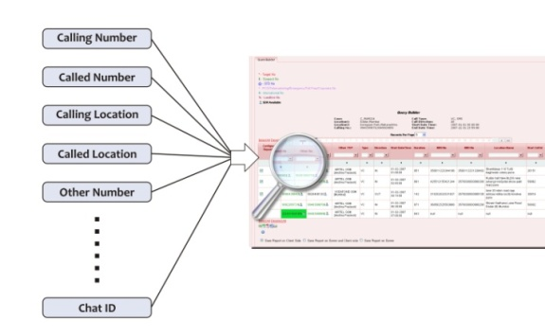
Why are we here ???
Now, This is Useful to Me!!!
All Country Data
Xalted InteliCENTER Platform
Reports usable by anyone for identifying the suspect
Inputs from LEAs, Case Management, Analysis & much more..
Automatic data query and presentable output with in depth analytics
Automatic Data Analytics

Slide 13
Security Analytics
Data Agnoustic
Real-time Correlation and Anomaly Detection of Diverse Security Data
360* View
Explore about any Case related Suspects or create a New Case
Explore a suspect’s call, e-mail, chat, travel, and financial data
Explore a suspect’s location details in Map
Queries
High-Speed Querying of Security Intelligence Data
Patterns
Configure Suspicious Patterns on the entire data universe, Monitor Patterns and detect suspicious activities and entities associated
Provides insights into a Person’s Suspicious Activities through the configured patterns
Analysis
Enhanced Analysis for Deep Visibility
Flexible big data analytics across structured and unstructured data – including security data; email, document and social media content; full packet capture data; business process data; and other information
Visualization
Graphical front-end tool for visualizing and exploring big data

Slide 14
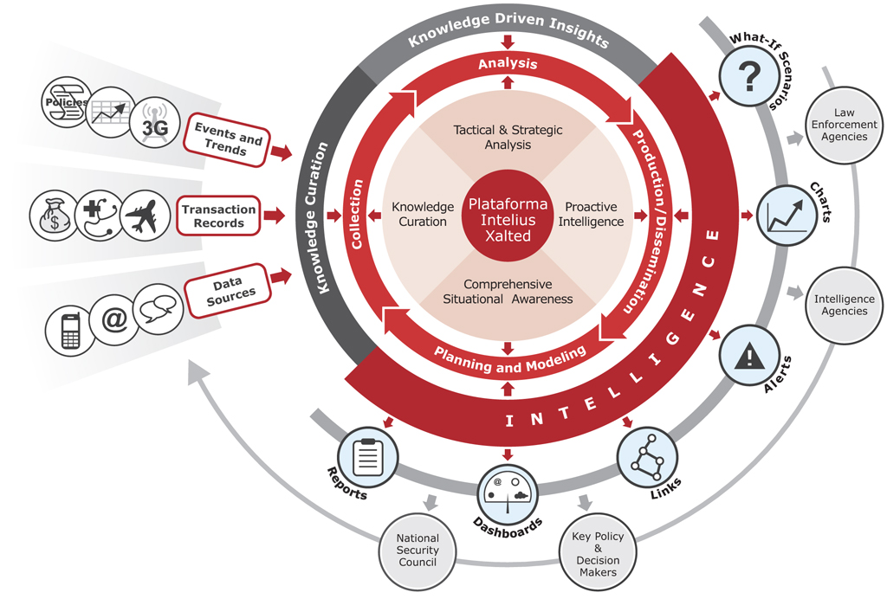
Results of Big Data Security Analytics
Number & Diversity of Sources
Notes:
There's so much data out there, which tracks the defense industry. "The question is, How do you take that data to make it usable, then to make it knowledge, and then to make it wisdom? Xalted is at the cutting edge of how to get to the wisdom piece.” As you can see from the diagram here, all types of sources can be handled in Xalted’sIneliCENTER platform, which can take all types of data and curates the data for knowledge. Curated data is further analyzed using InteliCENTER’s extensive product modules leading into Actionable Intelligence for making infromed decisions before a crime could occur.

Slide 15
PRISM by NSA
Large Volumes of Structured and Unstructured Data
Mining of Zettabytes of Data
Profiling Using Patterns
Extracting Actionable Intelligence
Enhanced Insights, Informed Decisions
Notes:
The success of PRISM is already known to most now as it has been a public news for a while. Let me close this session by stating - Xalted is like PRISM for National Security Agencies across the world.
Thank You and Xalted is open to any F&Q now.

Slide 16
InteliCENTER
Xalted has the TECHNOLOGY…
InteliCENTER – Security Intelligence Solution
Allows prevention of terrorism
Capable of forensic analysis
Solve crimes and terrorism related cases
Uses strategic and tactical analytical tools
Leads to informed decision making
Gains unparallel Security Intelligence

Slide 17
For more information please contact:
KaminiRupani
Vice President - Marketing
Xalted
Phone: +91 90042 88822
Email:Kamini.Rupani@XaltedCorp.com
Website: www.xaltedcorp.com

